Slide 1
Challenges in Pointer Analysis of JavaScript
Ben Livshits
MSR

Slide 2
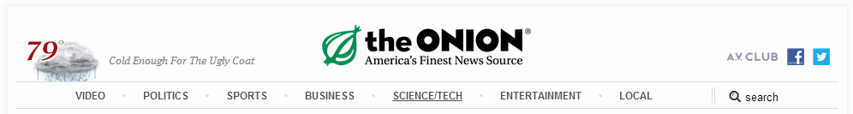
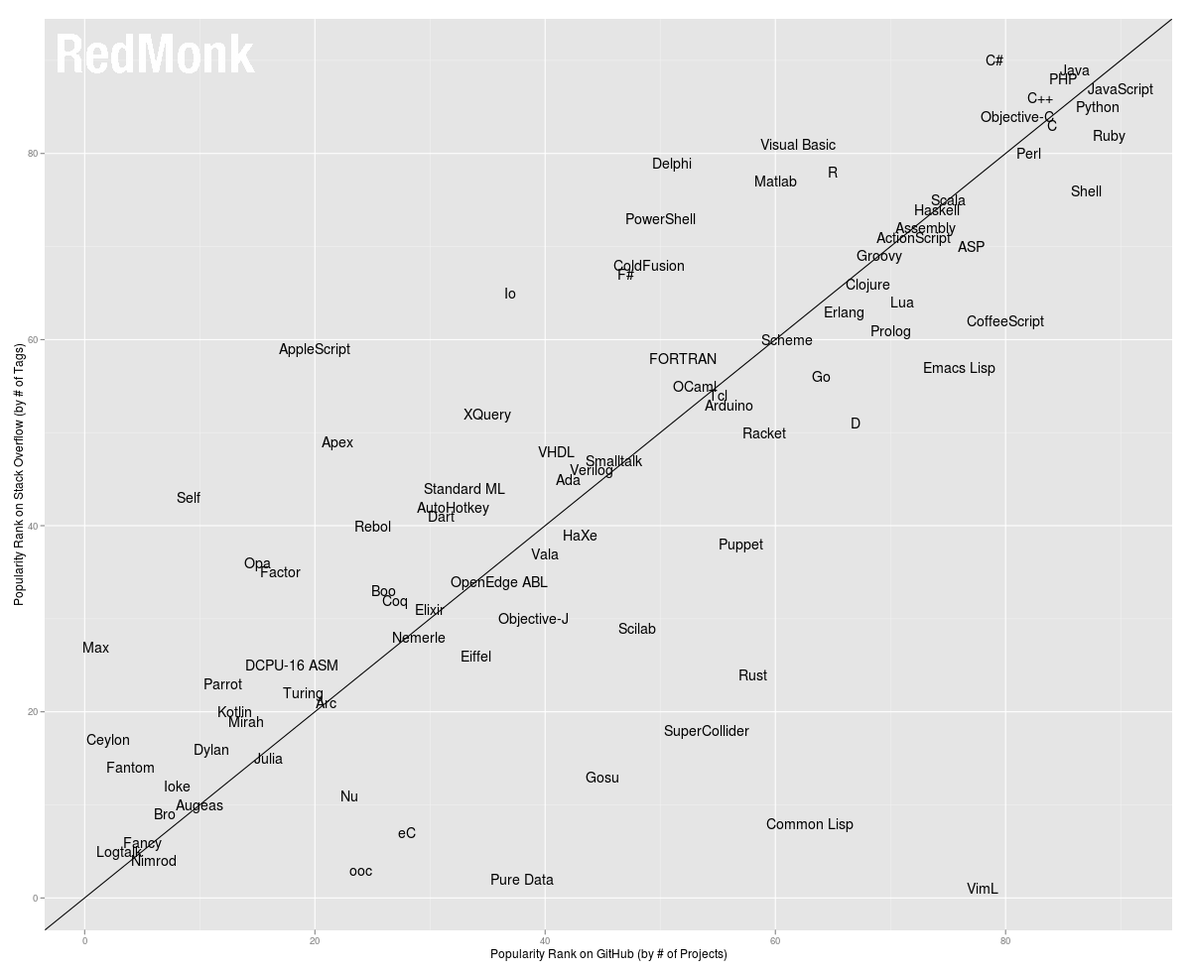


JavaScript
Area man says:
JavaScript leads the pack as most popular programming language

Slide 3
Two Issues in JavaScript Pointer Analysis

Slide 4
1is distributed
Gulfstream
JavaScript programs on the web are streaming
Fully static analysis pointer analysis is not possible, calling for a hybrid approach
Setting: analyzing pages before they reach the browser

Slide 5
2is distributed
Use analysis
JavaScript programs interop with a set of reach APIs such as the DOM
We need to understand these APIs for analysis to be useful
Setting: analyzing Win8 apps written in JavaScript

Slide 6
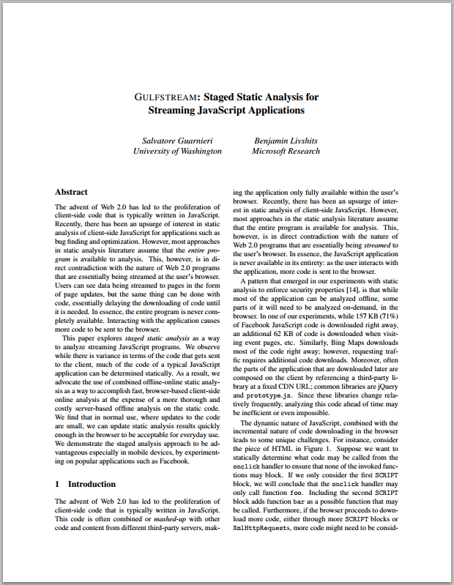
Gulfstream
Staged Static Analysis for Streaming JavaScript Applications, Salvatore Guarnieri, Ben Livshits, WebApps 2009

Slide 7
Whole program analysis?
What whole program?

Slide 8
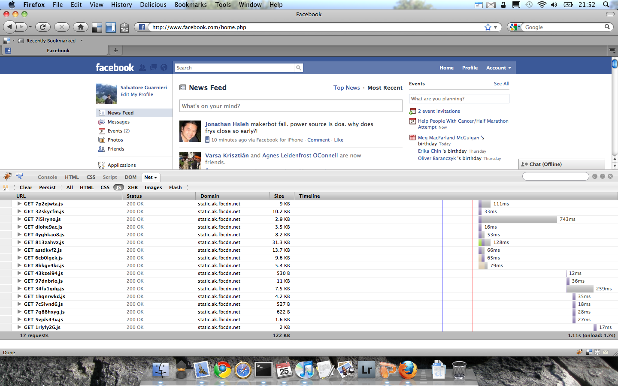

Slide 9
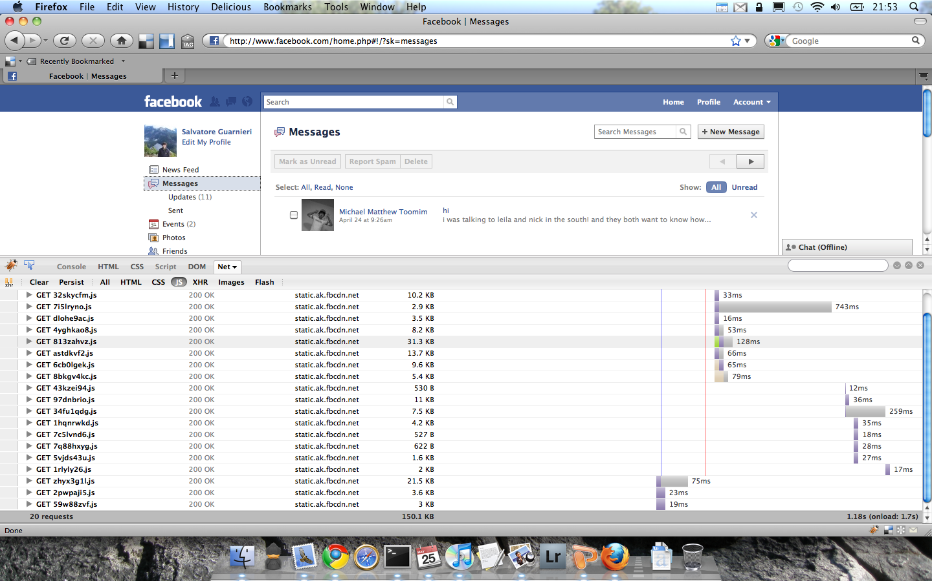
JavaScript programs are streaming
Notes:
You might be wondering how one does this

Slide 10
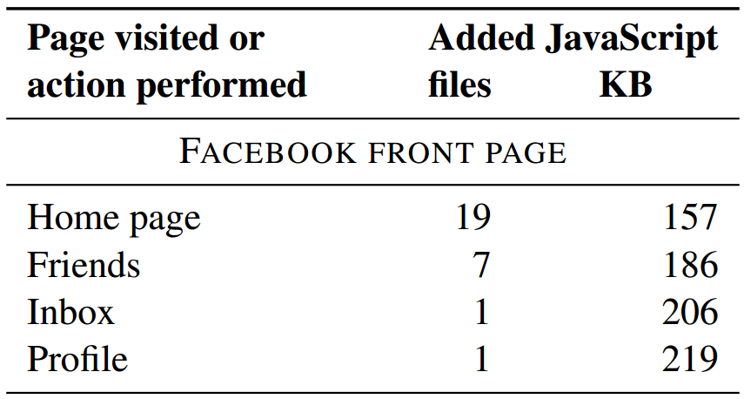
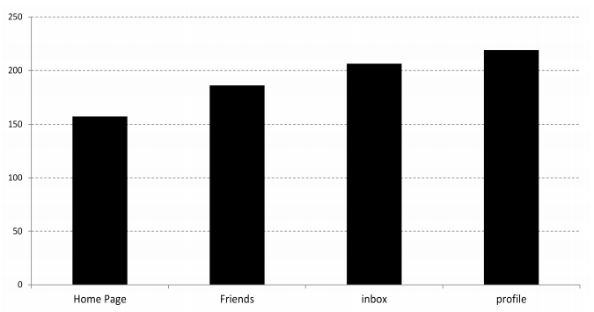
Facebook Code Exploration

Slide 11
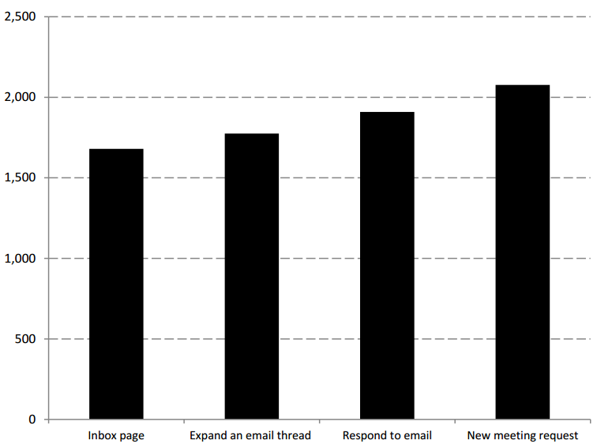
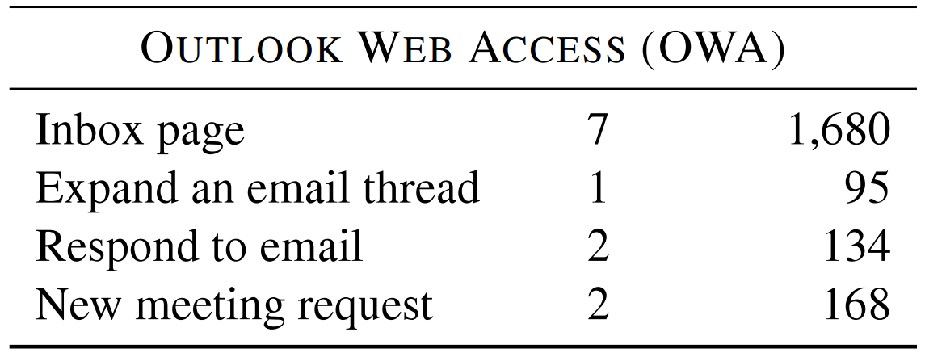
OWA Code Exploration

Slide 12
Script Creation
<HTML>
<HEAD>
<SCRIPT>
function foo(){...}
var f = foo;
</SCRIPT>
<SCRIPT>
function bar(){...}
if (...) f = bar;
</SCRIPT>
</HEAD>
<BODY onclick="f();"> ...</BODY>
</HTML>
What does f refer to?
Notes:
Tell call graph story

Slide 13
Plan
Server
Client
Pre-compute pointer information offline, for most of the program
Optionally update server knowledge as more code is observed
When more code is discovered, do analysis of it
Combine the incremental results with pre-computed results

Slide 14
Gulfstream In Action
✔
✔
✔
Is it faster to
transfer pre-computed results + add incremental results
Compute everything from scratch
Checking a safety property
Offline
Online
Notes:
Proceeds in 2 stages
Offline is done on server
Online is done in the browser

Slide 15
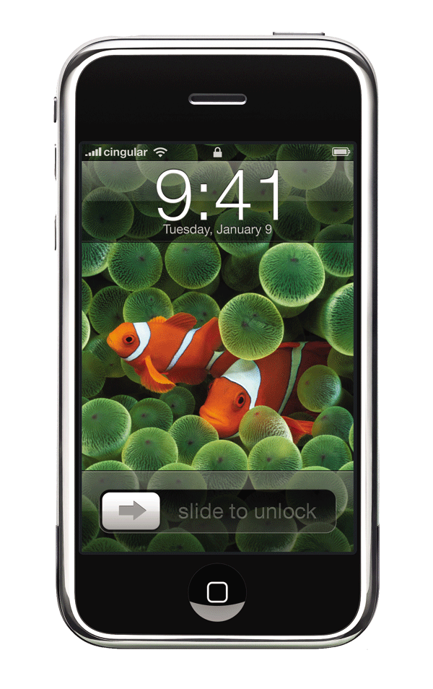
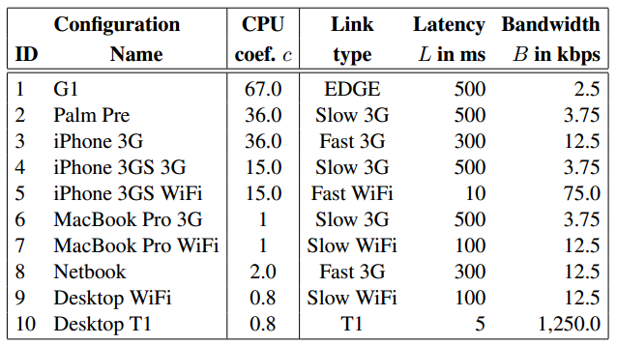



Simulated Devices
Notes:
For each device we have relative CPU speed, and network parameters. It is these parameters that allow us to compare the effectiveness of gulfstream on different devices

Slide 16
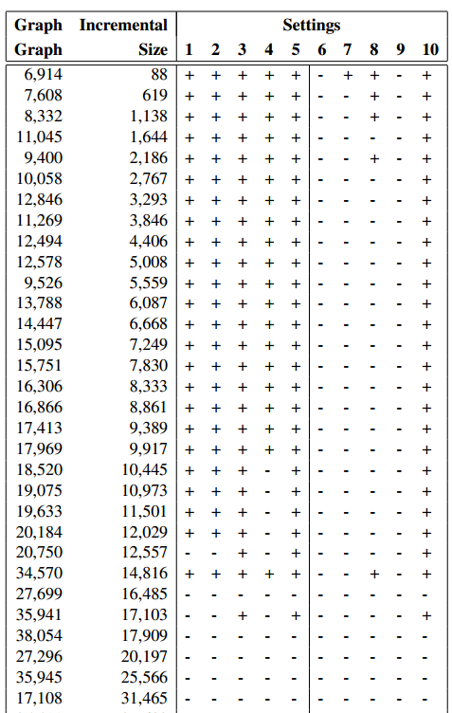
Try Different Configurations
Slow devices benefit from Gulfstream
A slow network can negate the benefits of the staged analysis
Large page updates don’t benefit from Gulfstream
“+” means that staged incremental analysis
is advantageous compared to full analysis on the client.

Slide 17
Gulfstream Savings: Fast Devices
10 seconds saved
Notes:
Savings were as much as 10 seconds

Slide 18
Gulfstream Savings: Slow Devices

Slide 19
Laptop Running Time Comparison
Break even point:
After 30KB of updates, incremental Gulfstream is no longer faster
Notes:
Explain static base page first
call out colors

Slide 20
Conclusion
Gulfstream, staged analysis for JavaScript
WebApps 2010
Staged analysis
Offline on the server
Online in the browser
Wide range of experiments
For small updates, Gulfstream is faster
Devices with slow CPU benefit most

Slide 21
Pointer Analysis and Use Analysis

Slide 22

Use Analysis
Practical Static Analysis of JavaScript Applications
in the Presence of Frameworks and Libraries, Madsen, Livshits, Fanning, in submission, 2013

Slide 23
Motivation: Win8 App Store
Native C/C++ apps
.NET aps
JavaScript/HTML apps

Slide 24
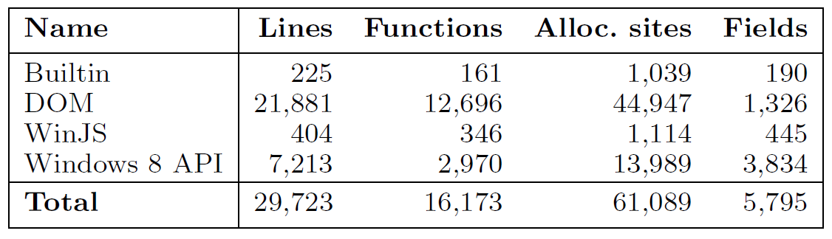
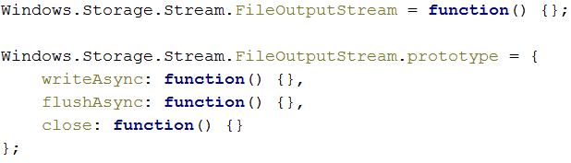
Win8 & Web Applications
Windows 8 App
Web App
Builtin
Builtin
DOM
DOM
WinJS
WinJS
Win8
Win8
Builtin
Builtin
DOM
DOM
jQuery
jQuery
…
…

Slide 25
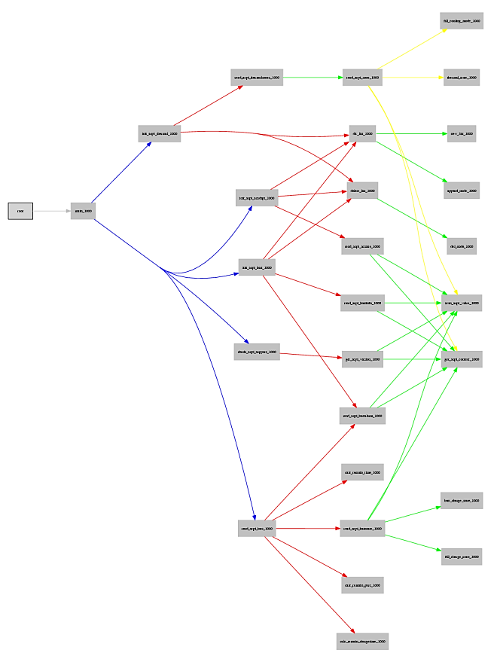
Practical Applications
Call graph discovery
API surface discovery
Capability analysis
Auto-complete
Concrete type inference
Runtime optimizations

Slide 26
Practical Applications
Call graph discovery
API surface discovery
Capability analysis
Auto-complete
Concrete type inference
Runtime optimizations
Windows.Devices.Sensors
Windows.Devices.Sms
Windows.Media.Capture
Windows.Networking.Sockets
…

Slide 27
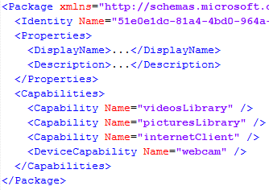
Practical Applications
Call graph discovery
API surface discovery
Capability analysis
Auto-complete
Concrete type inference
Runtime optimizations

Slide 28
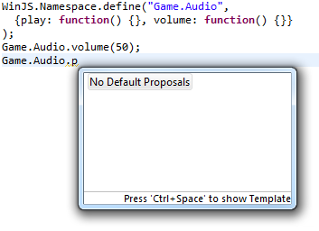
Practical Applications
Call graph discovery
API surface discovery
Capability analysis
Auto-complete
Concrete type inference
Runtime optimizations

Slide 29
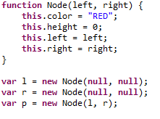
Practical Applications
Call graph discovery
API surface discovery
Capability analysis
Auto-complete
Concrete type inference
Runtime optimizations

Slide 30

Practical Applications
Call graph discovery
API surface discovery
Capability analysis
Auto-complete
Concrete type inference
Runtime optimizations
str
int
ref
ref
memory layout

Slide 31
Canvas Dilemma
var canvas = document.querySelector("#leftcol .logo");
var context = canvas.getContext("2d");
context.fillRect(20, 20, c.width / 2, c.height / 2);
context.strokeRect(0, 0, c.width, c. height);
model querySelector as returning a reference to HTMLElement:prototype
However, HTMLElement:prototype does not deﬁne getContext, so getContext remains unresolved
Model querySelector as returning any HTML element within underlying page
Returns elements on which getContext is undeﬁned

Slide 32
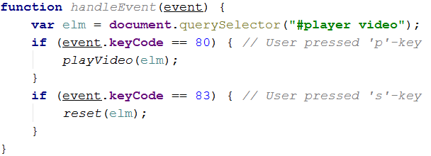
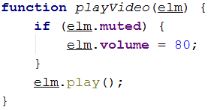

Introducing Use Analysis
elm flows into playVideo
elm flows into reset
elm must have:
muted and play
elm must have:
pause

Slide 33
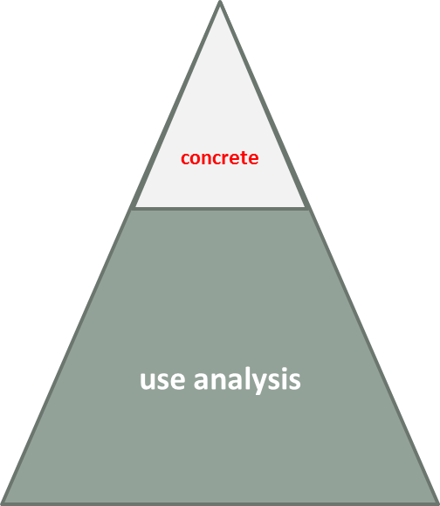
Pointer vs. Use Analysis
Pointer analysis deals with “concrete” facts
Facts we can observe
variables declared in the program
allocation sites

Slide 34
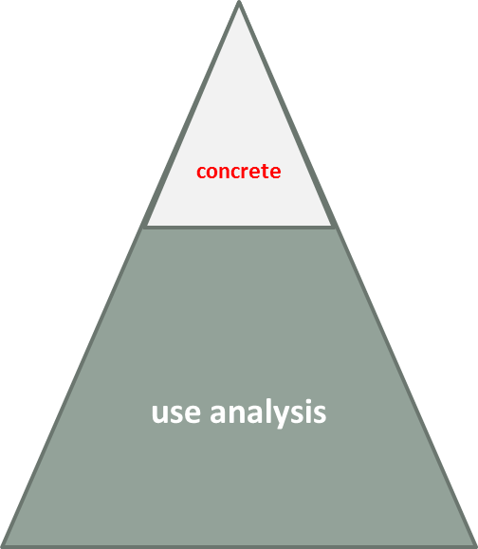
Pointer vs. Use Analysis
Use analysis deals with the “invisible” part of the heap
It can exist entirely outside the JavaScript heap
Constraints flows from callers to callees

Slide 35
Promises
driveUtil.uploadFilesAsync(
server.imagesFolderId).
then( function (results) {...} ))
analysis correctly maps then to
WinJS:Promise:prototype.then

Slide 36
Local Storage
var json =
Windows.Storage.
ApplicationData.current.
localSettings.values[key];
correctly resolves localSettings to an instance of Windows:Storage:ApplicationDataContainer

Slide 37
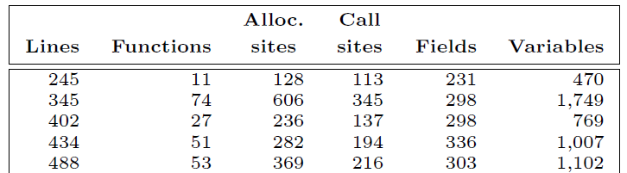
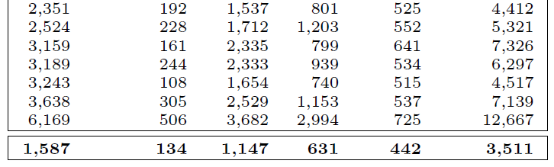
Benchmarks
25 Windows 8 Apps:
Average 1,587 lines of code
Approx. 30,000 lines of stubs
Notes:
Average ~1.500 lines of code compared to almost ~30.000 lines of library stubs.

Slide 38
Evaluation: Summary
The technique improves call graph resolution
Unification is both effective and precise
The technique improves auto-completion compared to what is found in four widely used IDEs
Analysis completes in a reasonable amount of time

Slide 39
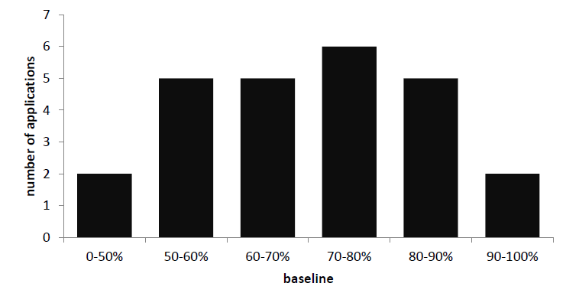
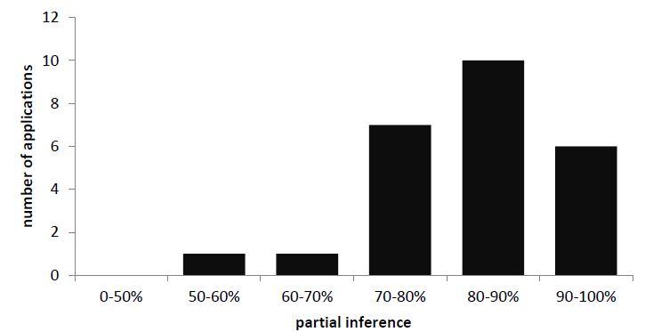
Call Graph Resolution
Median baseline resolution is 71.5%
Baseline
Median partial resolution is 81.5%
Partial

Slide 40
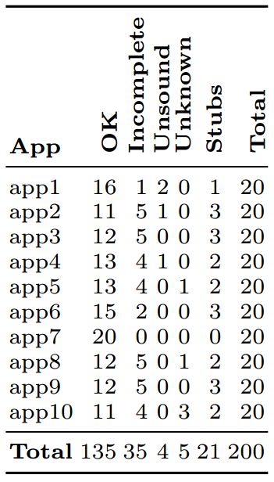
Validating Results
Incomplete is # of call sites which are sound, but have some spurious targets (i.e. imprecision is present)
Unsound is the number of call sites for which some call targets are missing (i.e. the set of targets is too small )
Stubs is the number of call sites which were unresolved due to missing or faulty stubs.

Slide 41
Auto-complete
We compared our technique to the auto-complete in four popular IDEs:
Eclipse for JavaScript developers
IntelliJ IDEA
Visual Studio 2010
Visual Studio 2012
In all cases, where libraries were involved, our technique was an improvement

Slide 42
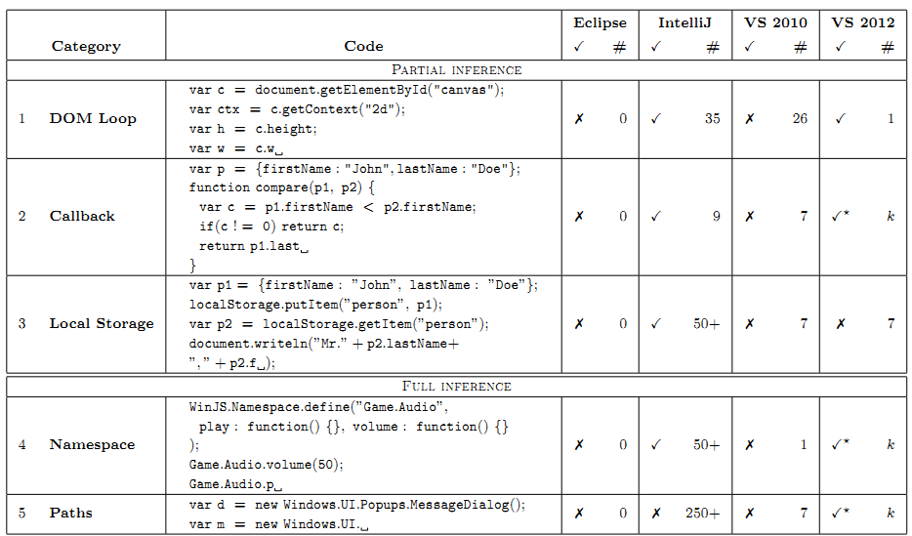
Auto-complete

Slide 43
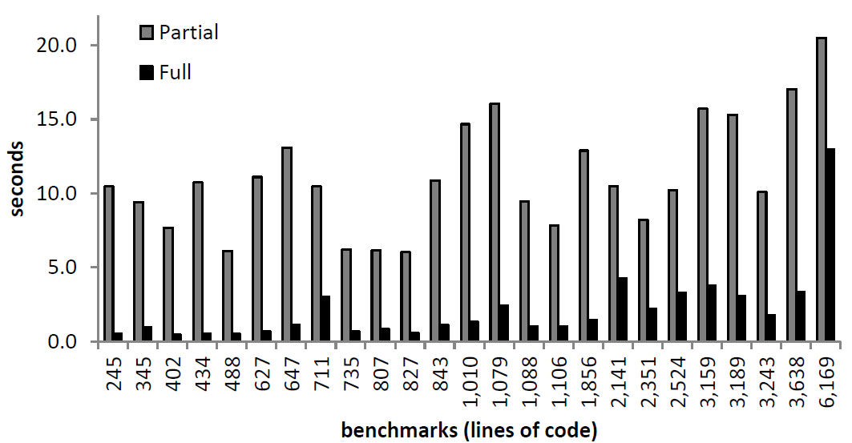
Running Times
All benchmarks complete within 22.0 sec
Median runtime for partial is 10.5 sec
Analysis is not incremental – room for improvement

Slide 44
Conclusion
We have presented a technique for handling large and complex libraries in static analysis of JavaScript applications
It is based on pointer analysis and use analysis
It is implemented declaratively in Datalog
It exists in two flavors: partial and full inference
We have evaluated our technique on 25 Windows 8 applications
Call graph resolution is improved
Running time is reasonable
We improve on auto-complete compared to four widely available JavaScript IDEs
We have shown a variety of practical applications

Slide 45
Two Issues in JavaScript Pointer Analysis
Gulfstream
JSCap
JavaScript programs on the web are streaming
Fully static analysis pointer analysis is not possible, calling for a hybrid approach
Setting: analyzing pages before they reach the browser
JavaScript programs interop with a set of reach APIs such as the DOM
We need to understand these APIs for analysis to be useful
Setting: analyzing Win8 apps written in JavaScript

